Slide 1
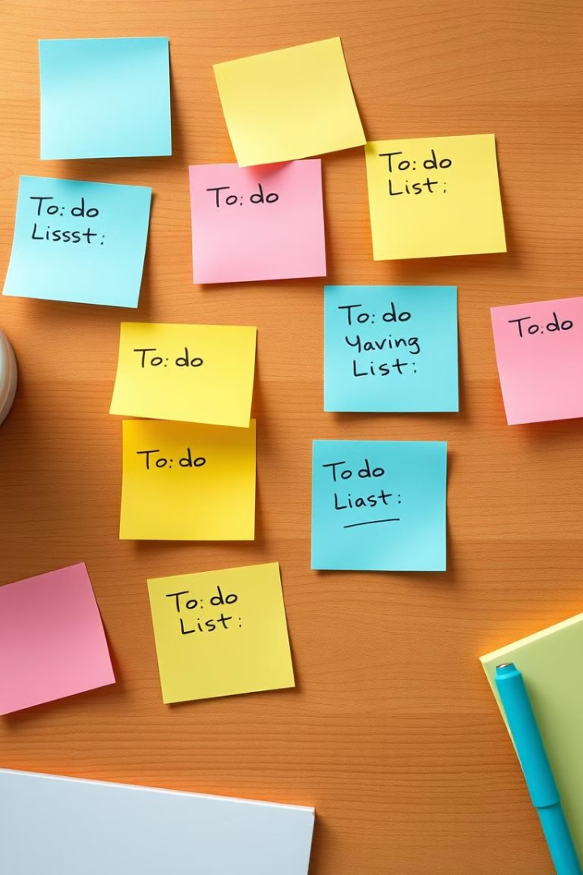
Simple To-Do List Application
Developing a simple to-do list application can be a great way to enhance productivity and organization in your daily life. By leveraging HTML, CSS, and JavaScript, you can create a user-friendly tool to manage your tasks efficiently.

Slide 2

Why a To-Do List is Essential for Productivity
1
Task Prioritization
2
Time Management
A to-do list helps you identify and focus on the most important tasks, ensuring you don't get sidetracked by less crucial items.
By breaking down your day into manageable tasks, you can better allocate your time and avoid feeling overwhelmed.
3
Improved Focus
Crossing off completed tasks provides a sense of accomplishment, boosting your motivation and keeping you on track.

Slide 3
Overview of HTML, CSS, and JavaScript
HTML
CSS
JavaScript
Responsible for the structure and content of web pages, providing the basic building blocks for the to-do list application.
Styles the visual appearance of the to-do list, ensuring it is aesthetically pleasing and user-friendly.
Adds interactivity and functionality to the to-do list, enabling features like task addition, deletion, and status tracking.

Slide 4
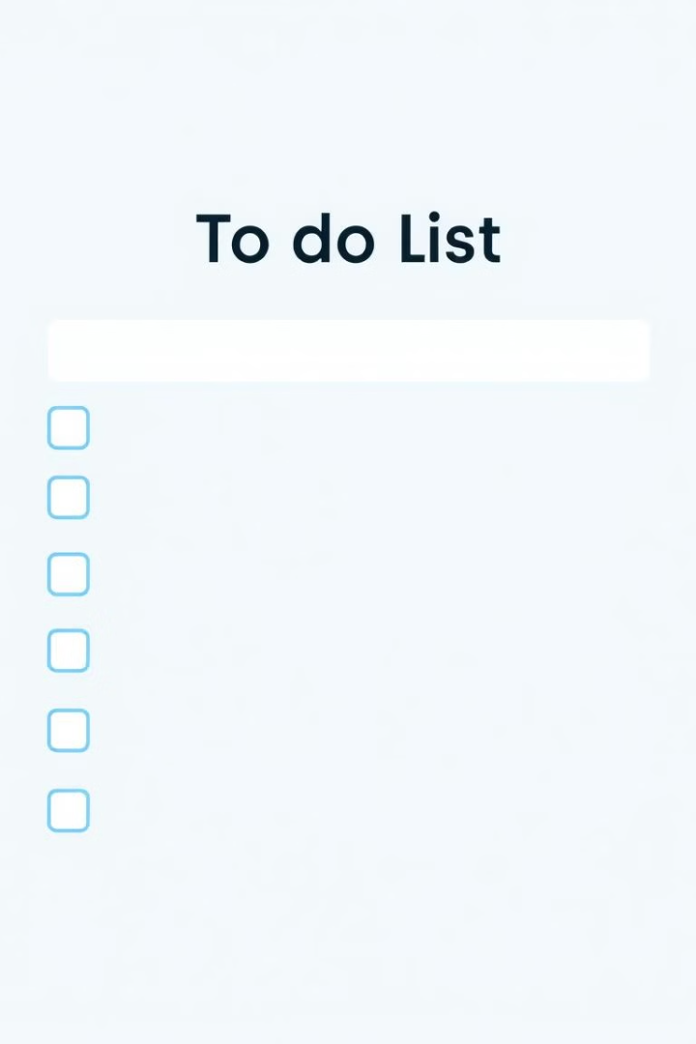
Building the To-Do List Interface
Input Field
Task Listing
Allows users to enter new tasks to be added to the list.
Displays the user's tasks, with the ability to mark them as complete.
Add Button
Triggers the addition of a new task to the list when clicked.

Slide 5

Adding Functionality with JavaScript
Event Listeners
UI Updating
Capture user interactions, such as clicks on the add button or checkbox ticks.
Dynamically update the interface to reflect the changes in the task list.
1
2
3
Task Management
Add, remove, and update tasks in the list based on user actions.

Slide 6



Saving and Retrieving Tasks with Local Storage
Data Persistence
Task Retrieval
Store the user's task list in the browser's local storage, ensuring data is retained even after the page is closed.
Automatically load the user's saved tasks when the application is reopened, providing a seamless experience.

Slide 7

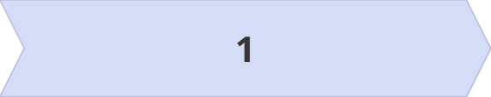
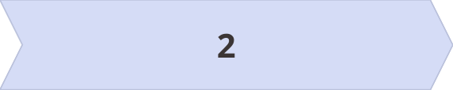
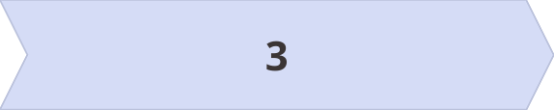
Organizing and Prioritizing Tasks
Grouping
Prioritization
Scheduling
Categorize tasks into different groups, such as work, personal, or errands, for better organization.
Assign priorities to tasks, allowing users to focus on the most important items first.
Set due dates for tasks and view them in a calendar view to stay on top of deadlines.

Slide 8

Conclusion: The Power of a Simple To-Do List
A well-designed to-do list application can be a powerful tool for improving productivity, organization, and overall life management. By leveraging HTML, CSS, and JavaScript, you can create a customizable and user-friendly solution to help you stay on track and achieve your goals.

